Slide 1
Cycling and Public Rights of Way Kevin Ridpath Graeme Clark

Slide 2
Introduction
The presentation will firstly cover cycling in the borough, including the Cycling Strategy, and then Public Rights of Way.
It will provide relevant background information for Members.
It will then cover related actions in the Service Plan for 2014/15.
Finally it will suggest some points which Members may wish to consider.

Slide 3
Cycling and the North Tyneside Cycling Strategy

Slide 4
Cycling (Background)
In 2004, an independent audit commissioned by central government was carried out by the English Regions Cycle Development Team (ERCDT).
The audit was critical of several aspects of North Tyneside’s provision. The main recommendations were:
To make cycling integral to scheme design
To develop links to the international ferry terminal to directly support the National Cycle Network
To deliver the National Standard Bikeability cycle training
To develop Safer Routes to Schools
To develop and improve routes to key employment sites

Slide 5
Waggonways Project
The historic 19th century Waggonways network was once used to haul coal to ships on the River Tyne.
In 2000 North Tyneside Council successfully bid for over £2m worth of funding to transform more than 30 miles of routes as part of the Government's Liveability Fund.
The Network was further supported by a dedicated maintenance team working in unison with stakeholders and Northumbria Police.
The Waggonways today play a key role in hosting sections of 3 National Cycle Network routes.

Slide 6
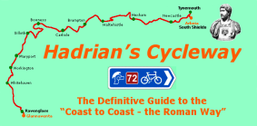
National Cycle Network routes in North Tyneside
Reivers Cycle Route (NCN 10)
North Shields Fish Quay – Cobalt –
Weetslade Country Park (to Whitehaven)
Hadrian’s Cycleway (NCN 72)
Shields Ferry – Redburn Dene –
Wallsend (to Ravenglass)
Coast and Castles (NCN 1)
Shields Ferry – Tynemouth – Whitley Bay
(international North Sea Cycle Route)
Aim to secure National Cycle Network
status for the Coast Road Cycleway

Slide 7
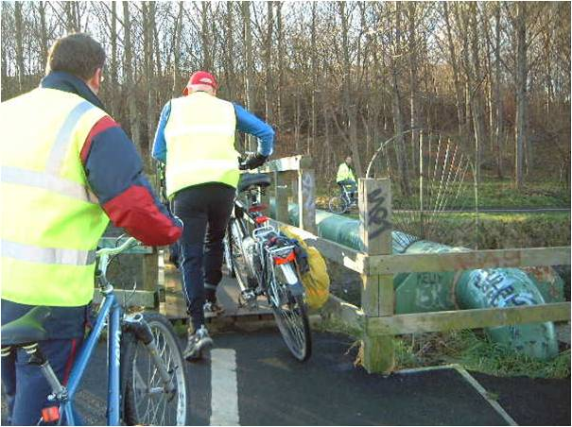
Connecting the Network
The old Willington Gut Bridge on Hadrian’s Cycle Way (Inaccessible)

Slide 8
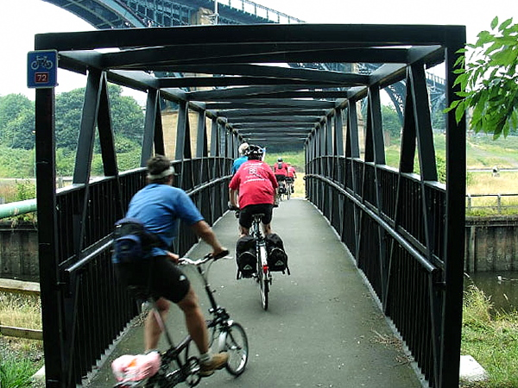
Replacement bridge recycled from Kings Cross

Slide 9
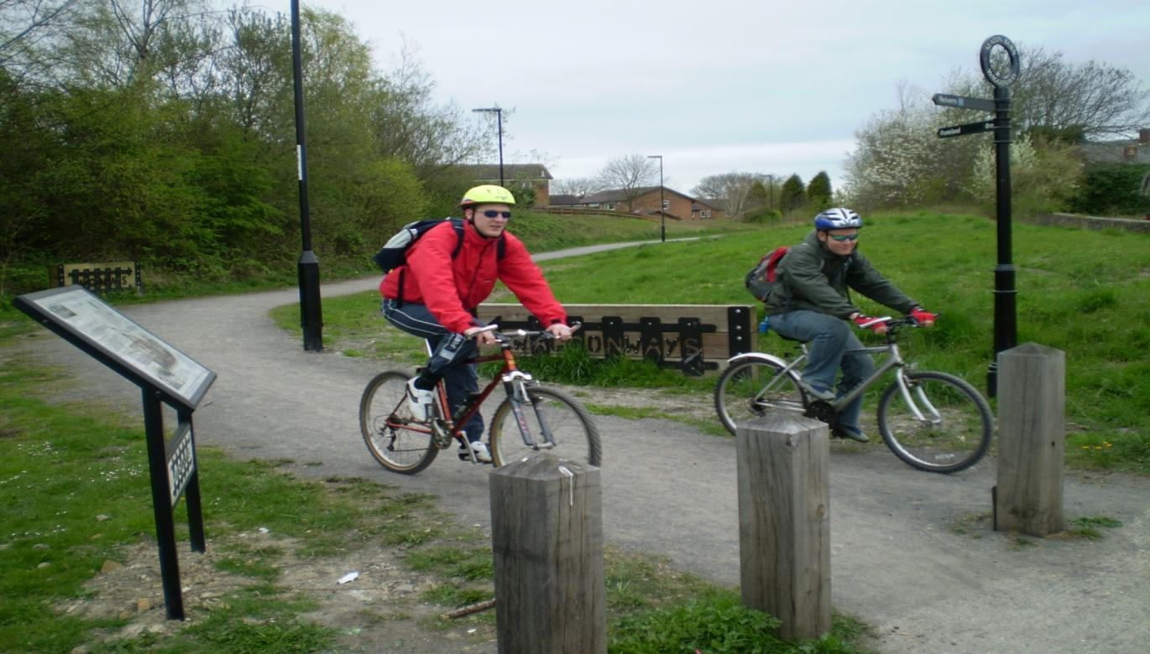
Waggonways Routes: Reivers Cycle Way Seaton Burn

Slide 10
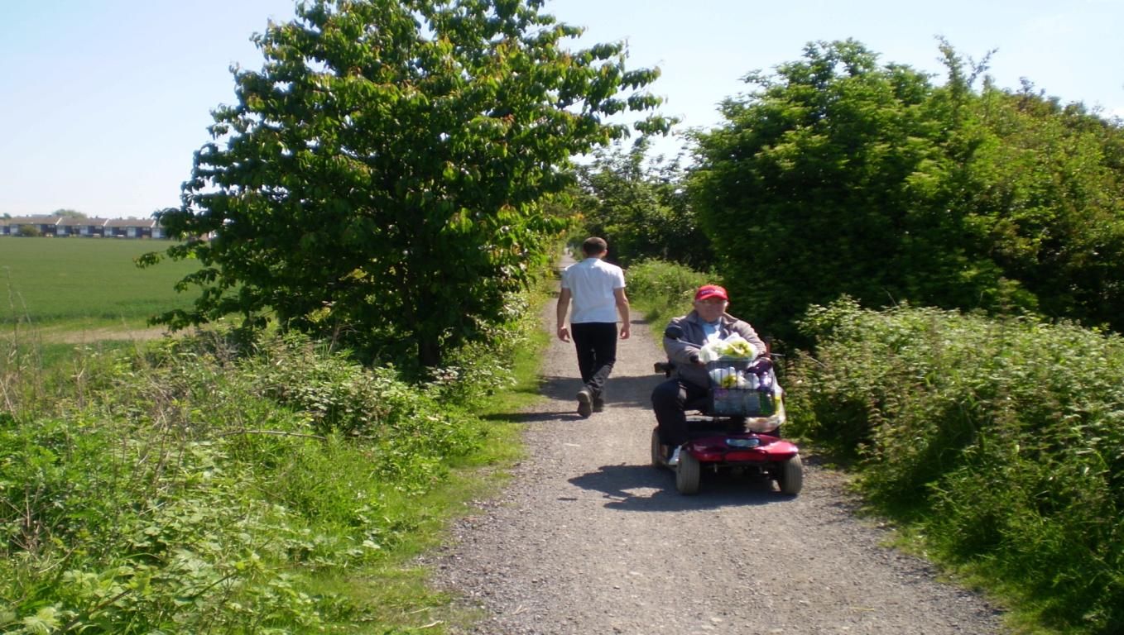
Waggonways Routes: Access for all (Burradon to Weetslade)

Slide 11
With financial pressures, investment contracted and became limited mainly to maintaining the existing network and externally funded works. Maintenance is undertaken but limited. The main source of complaints relate to matters such as overgrown vegetation leading to a deterioration in surface standards.
Financial Constraints and External Funding

Slide 12
Opportunities are sought to lever in external funding for improvements where possible: in most cases a local contribution is still required. Examples including joint working with: - the former Tyne and Wear Integrated Transport Authority (ITA) to improve cycle routes as part of the refurbishment of the Tyne Pedestrian and Cyclist Tunnels - the Highways Agency, to install crossings at A19 Holystone interchange and secure cycle-pedestrian bridges over slip roads as part of the Silverlink major scheme
Joint working with external partners

Slide 13
Four Lane Ends-A188 junction improvements – funded through Local Pinch Point Fund; also improves walking and cycling route to Quorum Business Park Coast Road (Billy Mill and Norham Road) major scheme – opportunities for improvements to Coast Road cycleway Strategic Economic Plan (SEP) – potential funding for cycle infrastructure Joint working with Sustrans e.g. on the Cycle Safety Fund scheme at Beach Road-Preston North Road roundabout

Slide 14
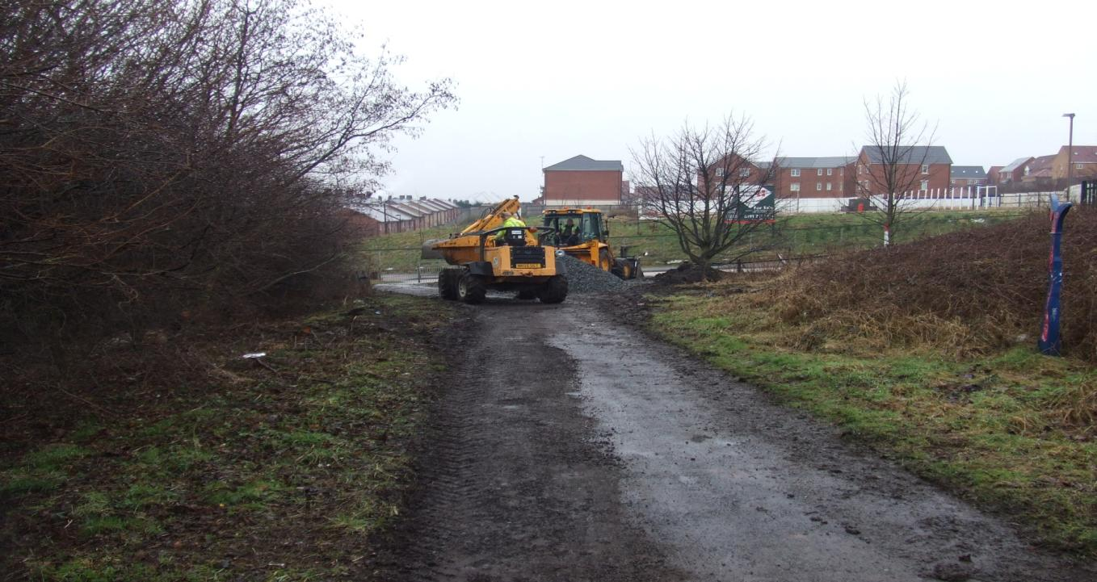
Funding secured through Tyne Tunnels works to connect Willington Quay with East Howdon Village via the A19 overpass (Hadrian's Cycle Way) (before)

Slide 15
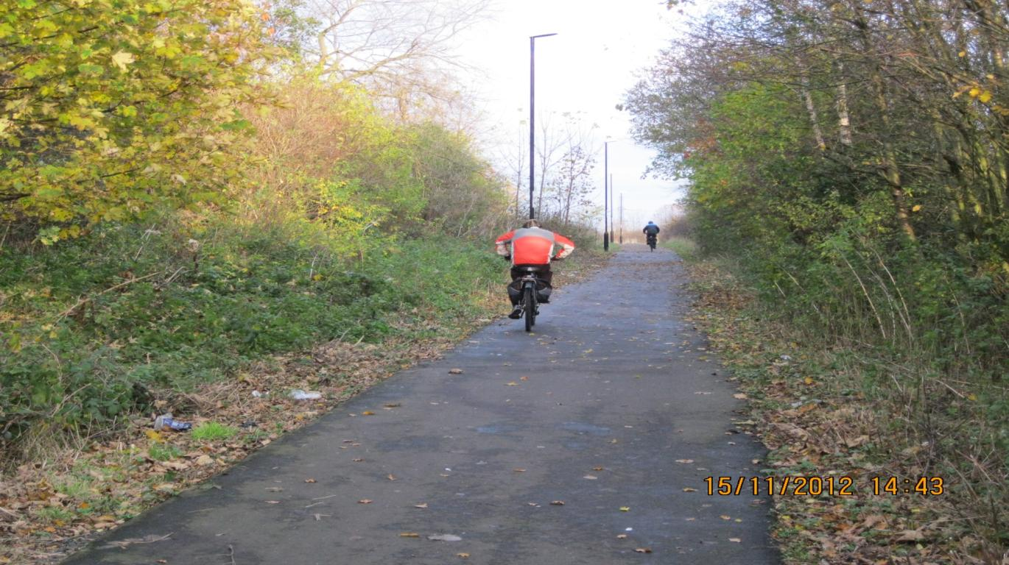
Vegetation cleared, path fully resurfaced and lighting installed (after)

Slide 16
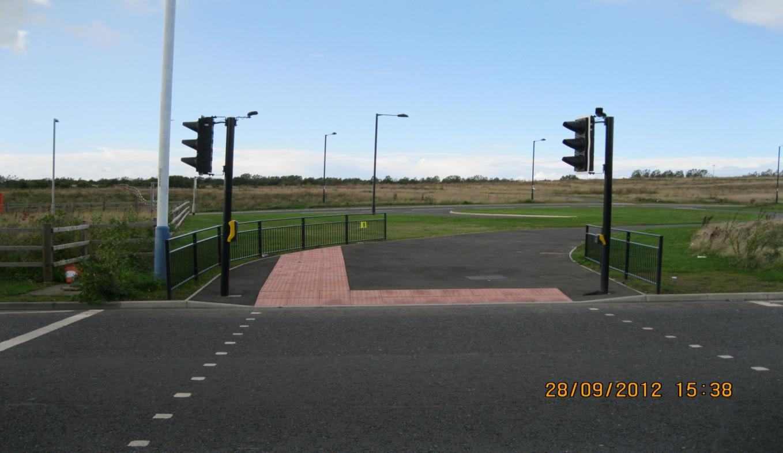
New crossing over East Howdon Bypass

Slide 17
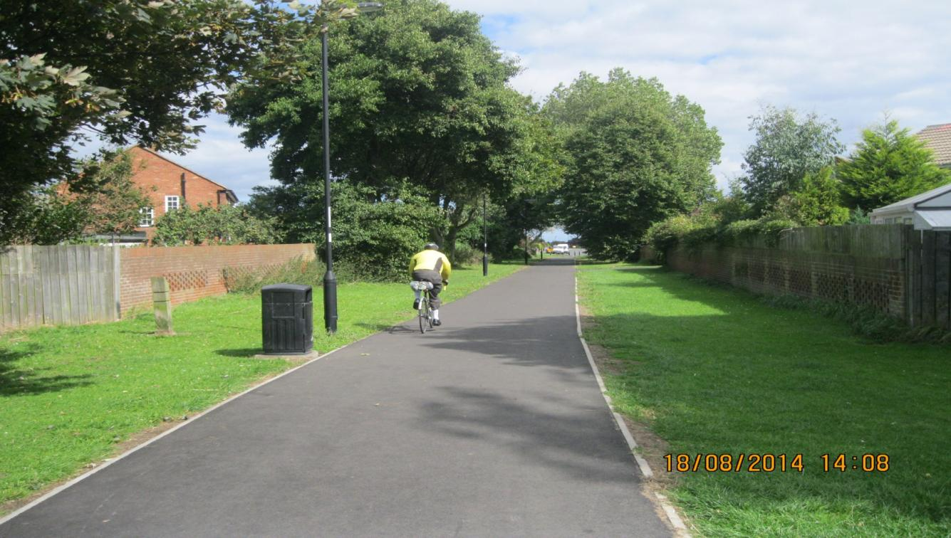
Joint working with Sustrans – Rake Lane to Cullercoats

Slide 18
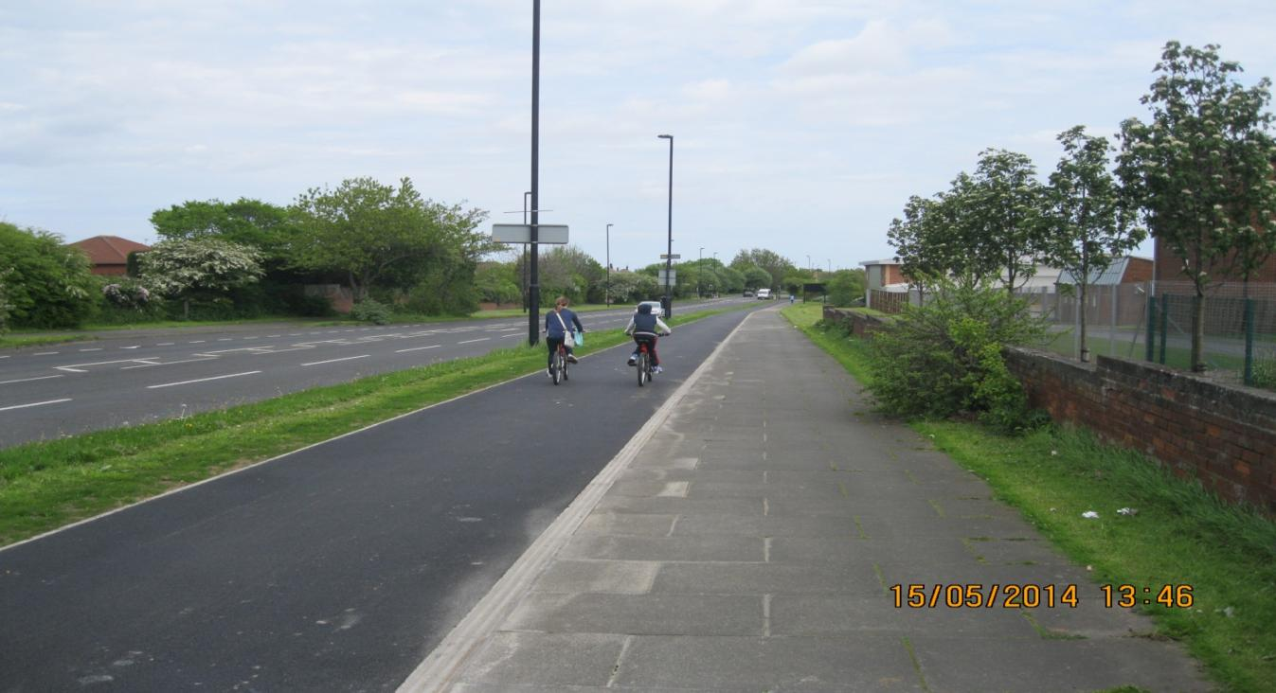
Joint working with Sustrans - Beach Road heading East to Broadway

Slide 19
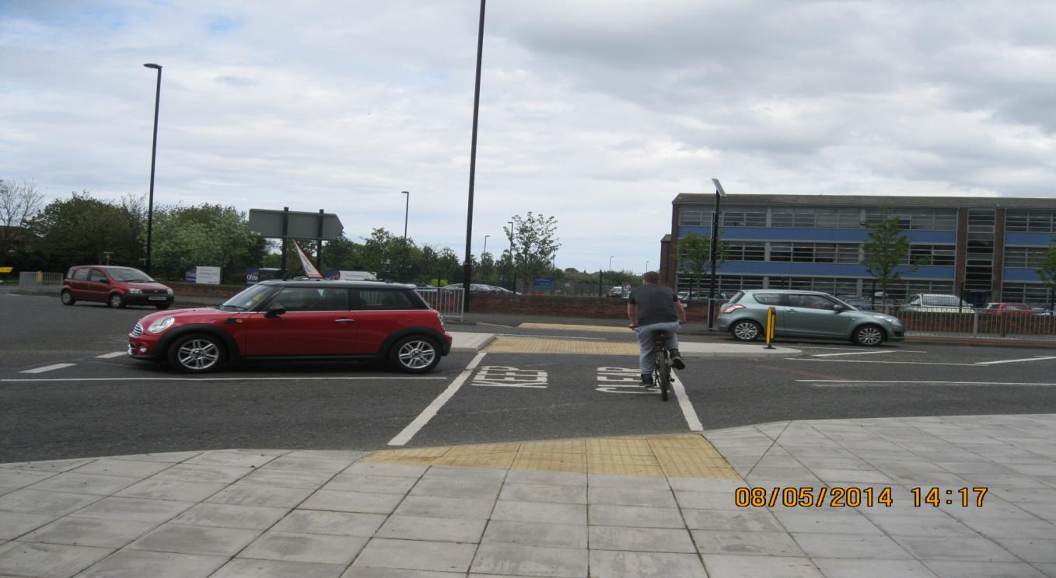
Improved road safety (Tynemouth Pool to John Spence High)

Slide 20
Bikeability national standard cycle training for school students – funded by a specific government grant; Technical Partner and Sports Development working to expand delivery Tyne and Wear LSTF (Local Sustainable Transport Fund) – delivers projects in schools in partnership with voluntary sector organisations, e.g. Sustrans on Bike It and FEAT 1st (Families Enjoying Active Travel); with Living Streets on Walk once a Week. Free Cycle Maps distributed across the region and now on their 3rd edition
Joint working – training and promotion

Slide 21
Increase in cycling
PERCENTAGE INCREASE ACROSS TYNE AND WEAR
Highway Authority | Growth 2004-2013
South Tyneside | 131%
Newcastle | 138%
Gateshead | 176%
Sunderland | 190%
North Tyneside | 211%
It is notable that the largest rise in North Tyneside has been in the Monday to Friday period when more commuting journeys are made, rather than at weekends when more trips may be for leisure.
Department for Transport statistics show that North Tyneside has the highest proportion of residents who cycle regularly (at least 5 times a week) in the North East.

Slide 22
National developments
The All-Party Parliamentary Group on Cycling recently launched the Get Britain Cycling report:
“We want to start a 'cycling revolution which will remove the barriers for a new generation of cyclists and encourage more people to take it up.
Business, local government, developers, road users and the transport sector can all play a vital role in helping to achieve this."

Slide 23
The Cabinet Member for Economic Development has sought a higher profile for cycling and placed increased emphasis on engagement with user groups. A workshop with cycling and rights of way user groups was held in January 2014. Issues raised included continuity of route networks; definitive map updating, surfacing, maintenance and cleansing of routes.
Further engagement

Slide 24
Cycling Strategy:
The Cycling Strategy 2010-14 is part of a vision to make North Tyneside the North East’s leading cycling borough by 2030. Long-term objectives of the 2030 vision are to:
Provide a seamless, on-road and off-road strategic network for cycling in North Tyneside
Promote cycling to residents and visitors as a healthy, sustainable travel option
Provide links to the National Cycle Network and other neighbouring networks
Put in place the infrastructure to support large-scale cycling, e.g. cycle parking
Offer on-road cycle training to all North Tyneside residents
Promote equality, accessibility and independent mobility for all
The strategy is to be updated as part of the Annual Service Plan.

Slide 25
Related Strategies:
Related strategies are just as important to delivering improvements in cycling. These include:
Local Plan, including LDD12 ‘Transport and Highways’
Tyne and Wear Local Transport Plan
Road Safety Strategy (forthcoming consultation)

Slide 26
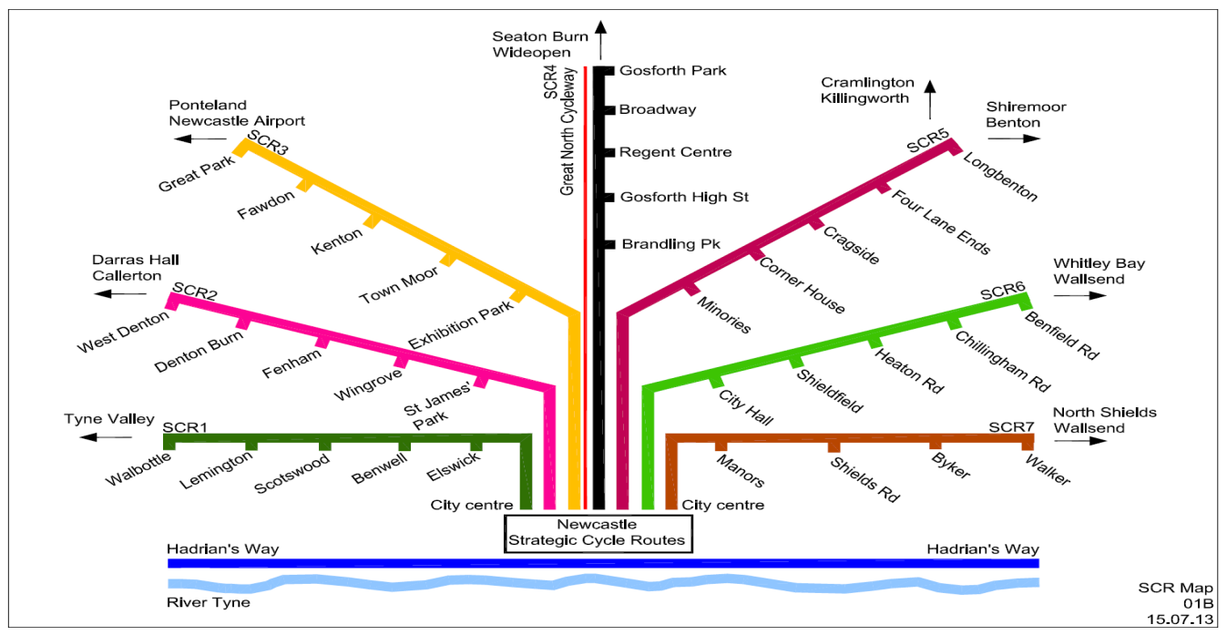
Newcastle City Council will focus their £5.8m central government award and match funding totalling £12.3m on key cycling routes.
Four of the 7 key routes will connect directly into North Tyneside.

Slide 27
Sustrans funded a study tour to Velsen in the Netherlands. Members and officers from several North East authorities attended, including the Chair of O&S Environment Sub-Committee, Cllr Brian Burdis. The borough of Velsen is demographically similar to North Tyneside with comparable levels of car ownership. However, sustained investment in high quality cycling infrastructure, with priority over side roads, has led to much higher levels of cycling among adults, children and family groups, and improved road safety.
Velsen Study Tour (Sustrans):

Slide 28
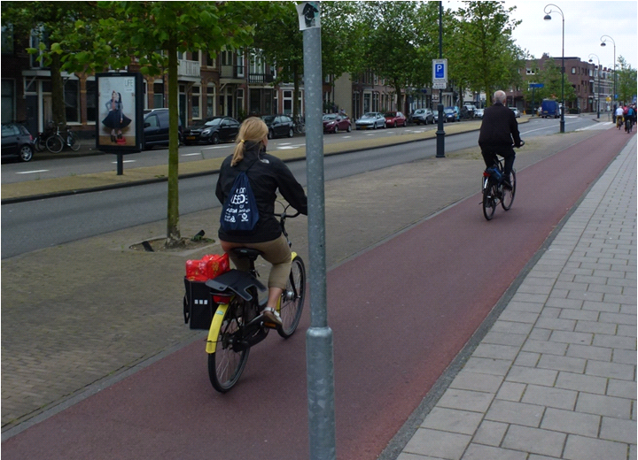
Velsen (cycle track with priority at side roads):

Slide 29
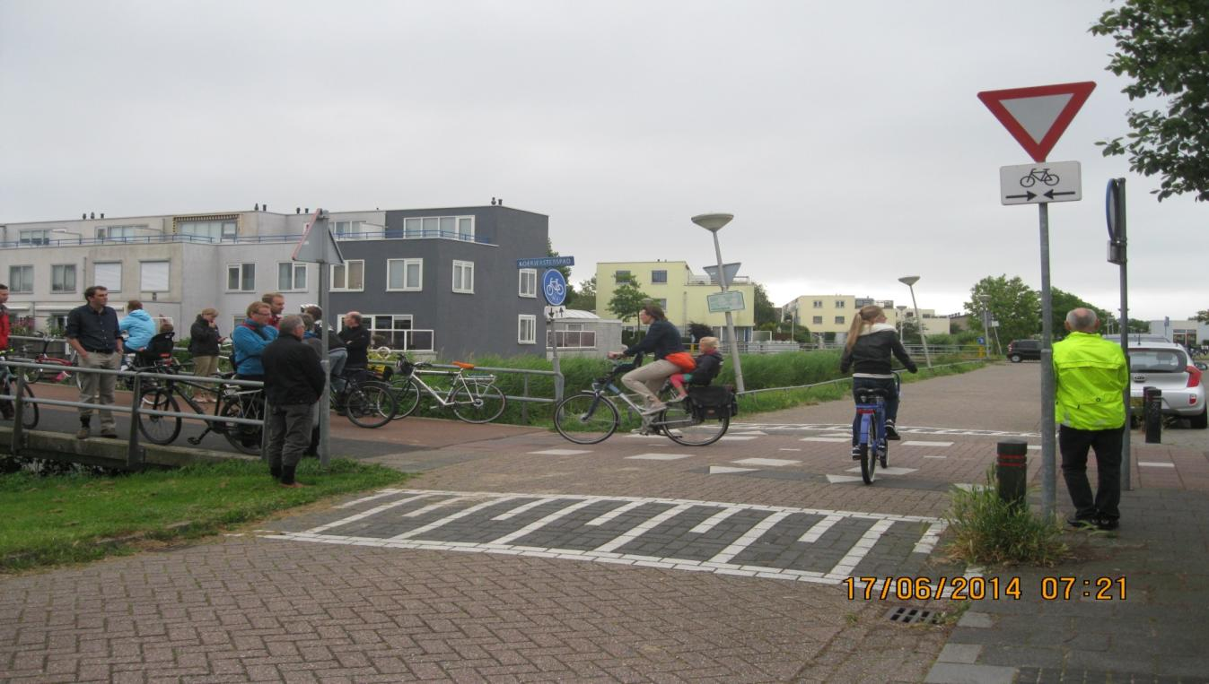
Velsen (Nursery school Run):

Slide 30
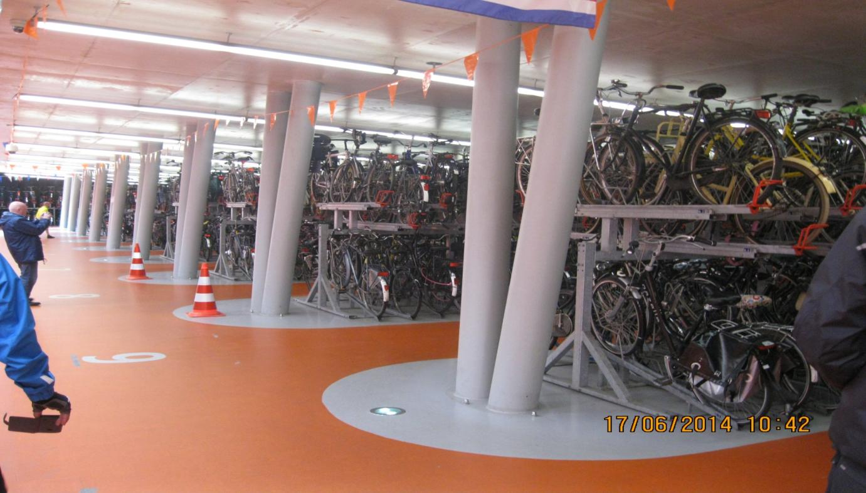
Haarlem (8000 bikes parked at commuter rail station):

Slide 31
Public Rights of Way (PRoW)

Slide 32
The Authority’s duty as a highway authority in respect of public rights of way is as follows:
Statutory duty
‘The Highway Authority is subject to a statutory duty to assert and protect the rights of public to the use and enjoyment of any highway including a duty to prevent, as far as possible, the stopping up or obstruction of all highways.’
(Highways Act 1980 s.130; amended by Countryside and Rights of Way Act 2000 s.63)

Slide 33
The Definitive Map and Statement are the legal record of the public's rights to use Public Footpaths, Public Bridleways, Restricted Byways and Byways Open to All Traffic. The Definitive Map must be constantly reviewed and updated. (Wildlife and Countryside Act 1981 s.53; modified by Countryside and Rights of Way Act 2000 s.53)
Definitive Map and Statement

Slide 34
The Countryside and Rights of Way Act 2000 encouraged local authorities to undertake a detailed study and programme to record the many routes for which public right of way had become established, but which are not on the Definitive Map. For all footpaths and bridleways in existence prior to 1949 but not on the definitive map, a lengthy process of investigation, negotiation with landowner, and addition to the map, must be completed for each route by the ‘cut-off’ date of 1 January 2026. Any routes that have not been added by that date will be extinguished and have all public rights removed.
The Cut-off Date:

Slide 35
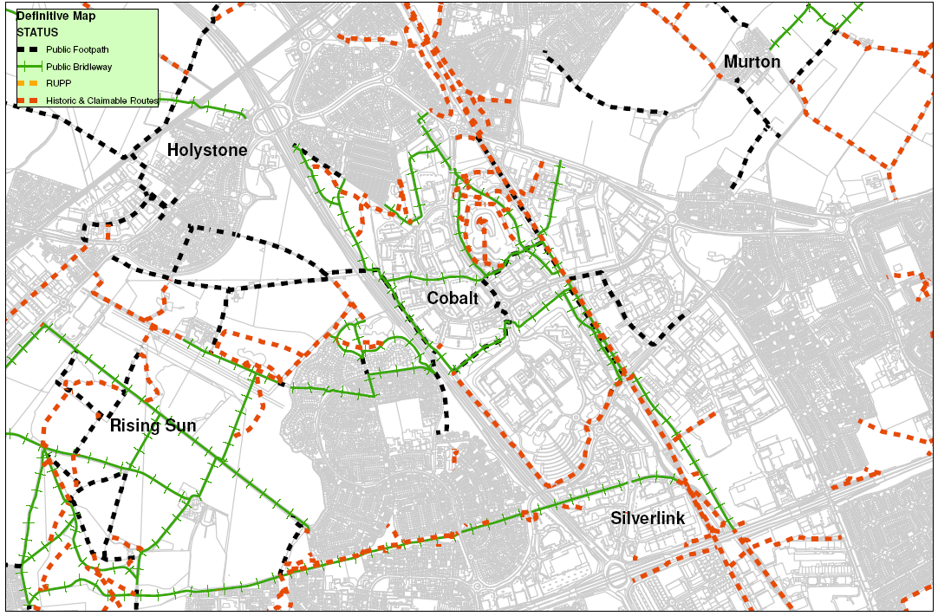
Example of ‘ways’ that have not been recorded around Cobalt Park (dashed red)

Slide 36
In North Tyneside we have 4 separate maps stemming from the old Urban District Councils, Northumberland and Tyne and Wear. The maps have never been consolidated and there are numerous routes in regular use which have not yet been added to the Definitive Map.
Consolidation of Definitive Map and List of Streets
List of Streets:
The data collation and subsequent publication of the consolidated map should be formally recorded on the ‘List of Streets’. (Section 36 of the Highways Act places a duty on the Authority to record all highways Maintainable at Public Expense, including all public rights of way.)

Slide 37
The Rights of Way Improvement Plan (RoWIP) forms an integral part of the Tyne and Wear Local Transport Plan. The Local Access Forum (LAF) is a statutory body made up of voluntary members appointed in partnership across Tyne and Wear to guide and assist the local authorities in their duties. Officers attend formal quarterly meetings to report to the forum and work directly with forum representatives at local level. Officers also work with stakeholders including Ramblers, British Horse Society and Bridleway Access Group.
Public Rights of Way Strategy and Statutory Engagement:

Slide 38
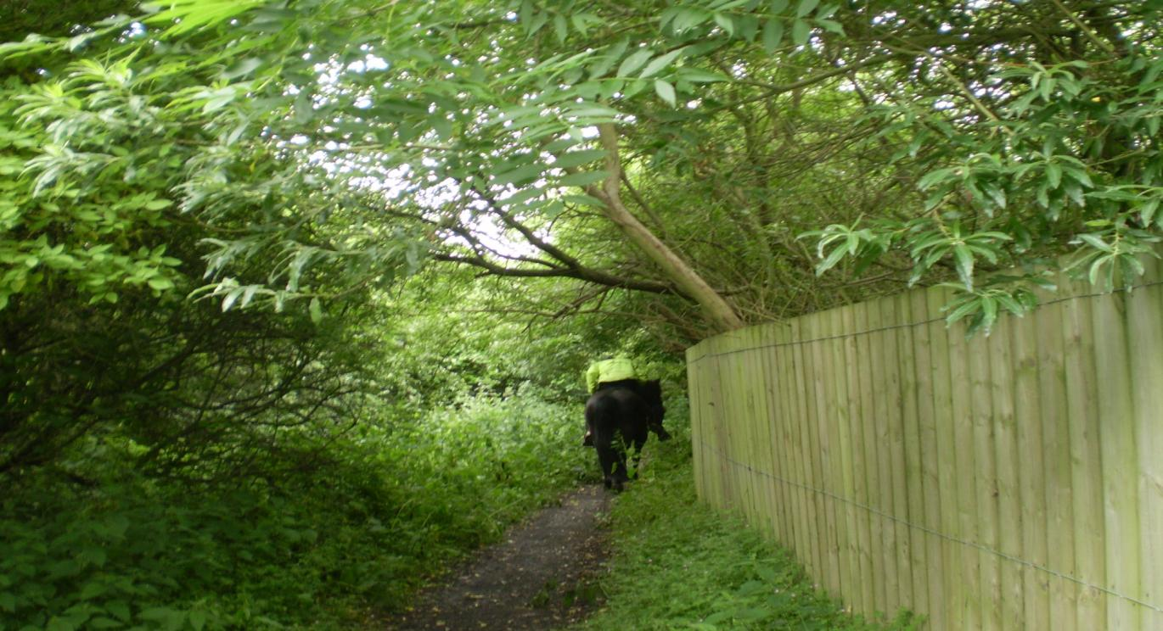
Overhanging vegetation (Seaton Burn) – under Highways Act, clearance should be 2.4m over a footpath and 5.2m for a Bridleway.

Slide 39
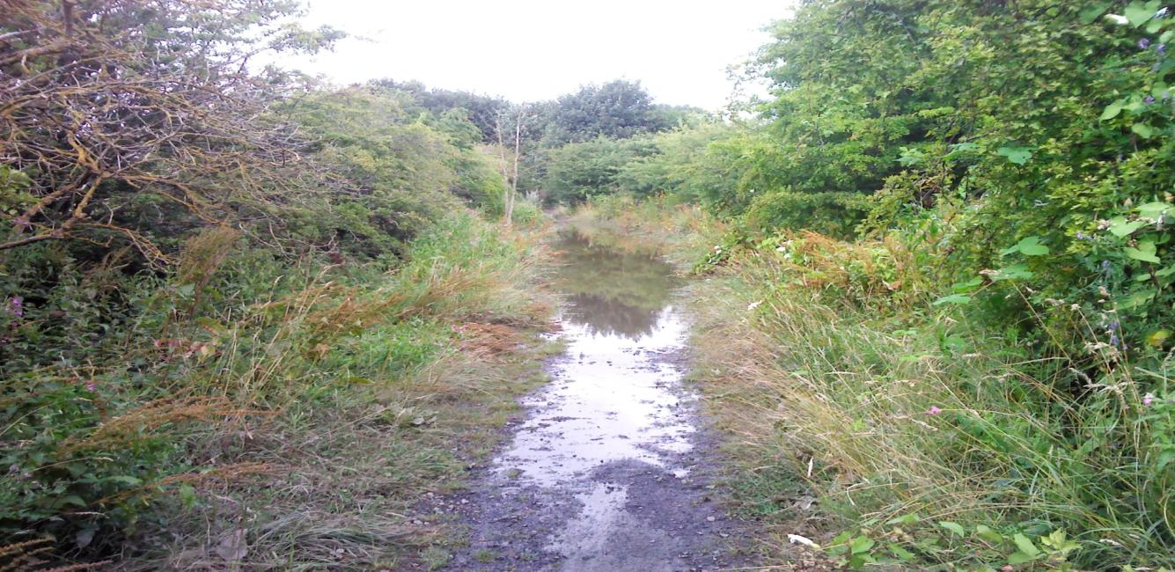
Maintenance is not only a statutory duty but an essential element to support the continued growth in usage.
Backworth (Flooding and Vegetation) (before)

Slide 40
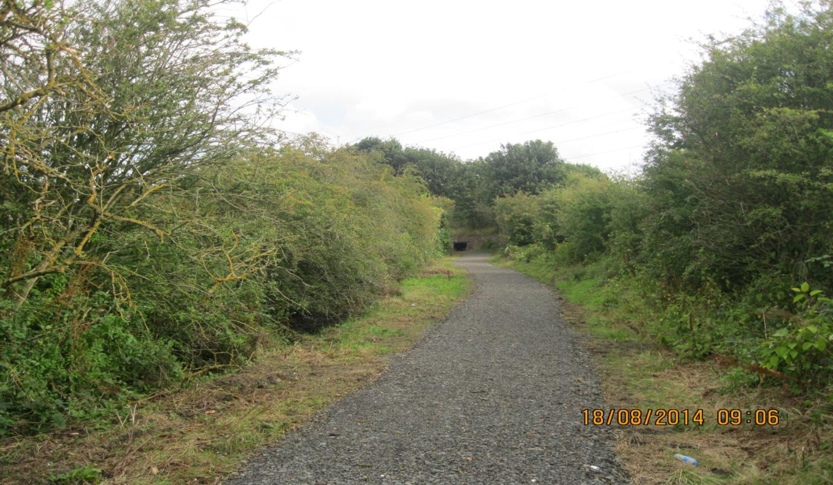
Backworth (after)

Slide 41
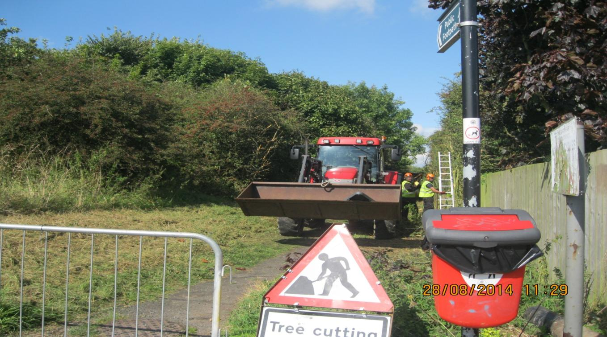
West Allotment (Works underway linking Cobalt to Holystone Roundabout)

Slide 42
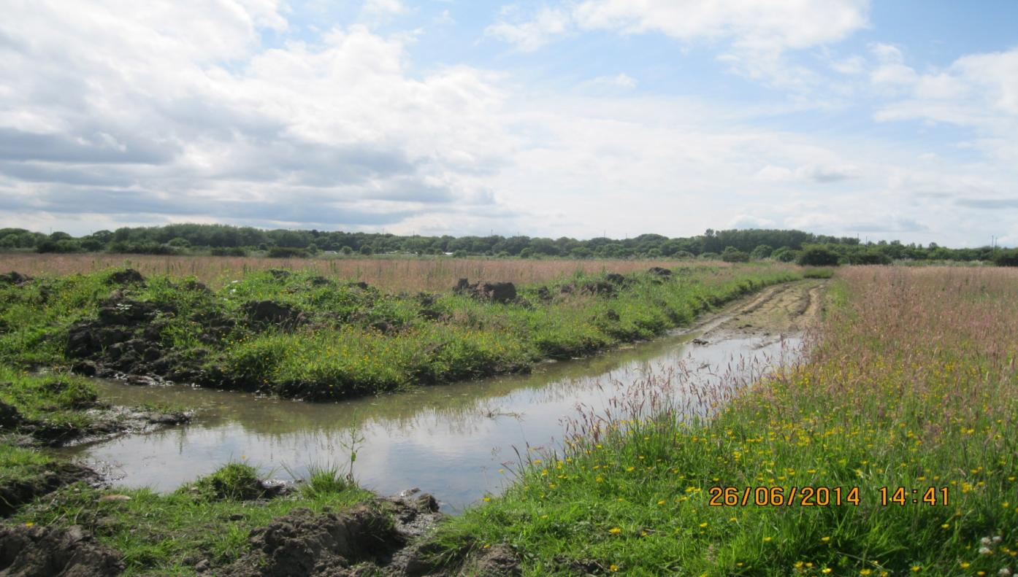
Enforcement issues: Whitehouse Farm (Bellway) (before)

Slide 43
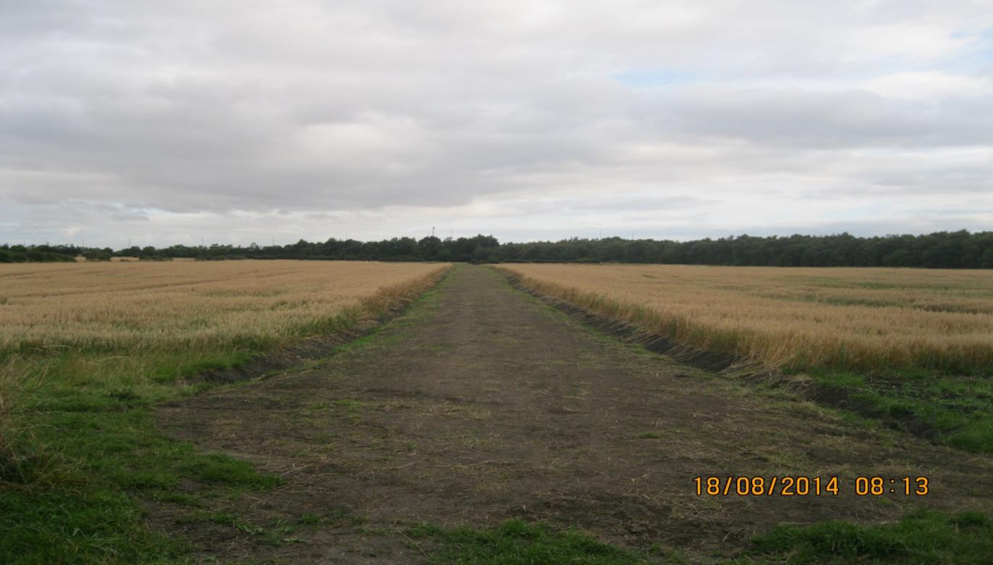
Whitehouse Farm (Repair paid for by Bellway) (after)

Slide 44
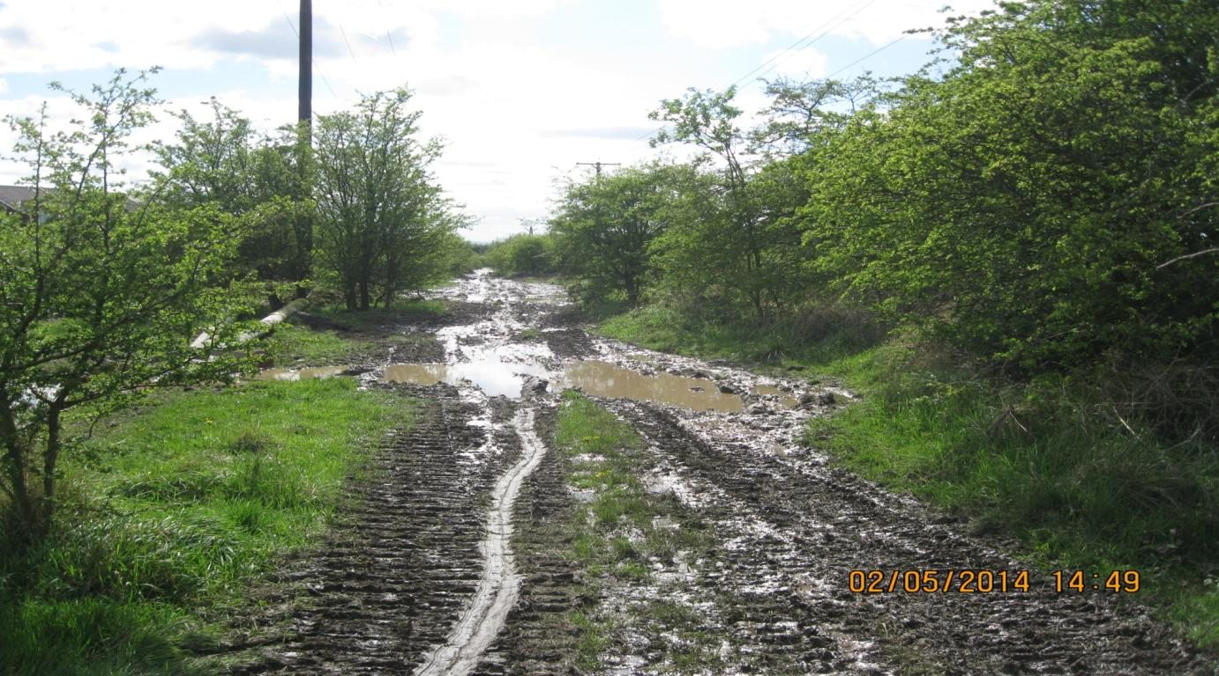
Scaffold Hill to Rising Sun (Northern Power Grid) (ongoing)

Slide 45
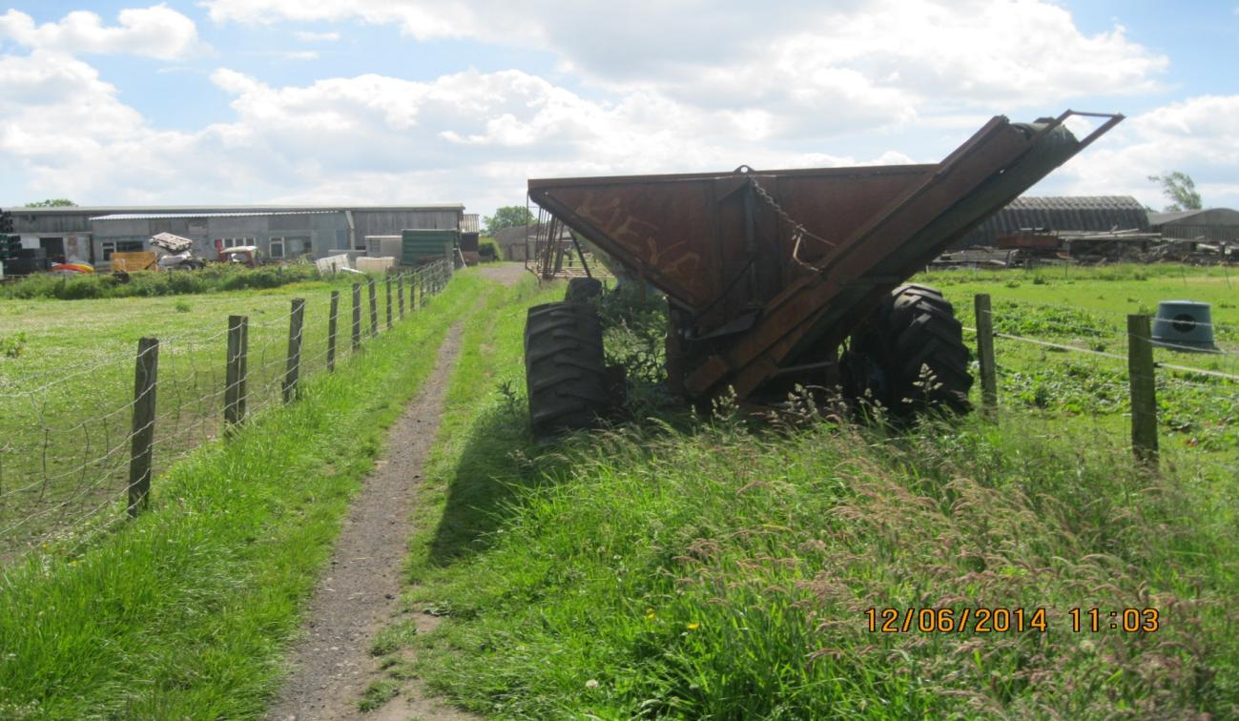
Holystone Farm (Full width obstructed)

Slide 46
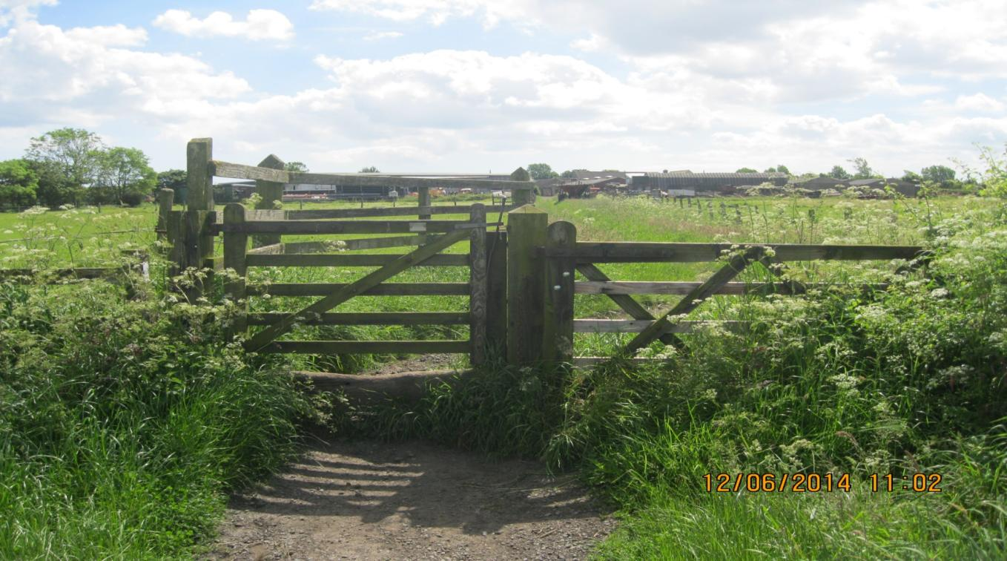
Holystone Farm (Gates must be approved by the Council)

Slide 47
Matters raised during engagement with stakeholders and user groups were taken into consideration in the preparation of the Annual Service Plan 2014/15. As part of this, the 2014/15 Action Plan includes the following: ES17: Definitive Map (Rights of Way) To determine priorities and programmes up to 2026 ES19: Cycling Strategy To develop a Cycling Strategy for the period from 2015
Annual Service Plan 2014/15:

Slide 48
Here are some questions which Members may wish to consider:
Cycling Network and Strategy:
Are the objectives of the 2030 Vision in the Cycling Strategy still appropriate?
Should North Tyneside’s cycling network aspirations be more clearly defined in the strategy?
Are there additional ways in which cycling can be promoted as a main mode of transport?
Should North Tyneside have a more clearly defined cycling network?
Should infrastructure for cycling be closer to international best practice?
Public Rights of Way:
What are the implications of the 2026 cut-off date to record paths on the Definitive Map?
To what extent are the expectations of public rights of way users being met?
Is maintenance on the Public Rights of Way network at an appropriate level and are there means of securing additional third party contributions to maintenance?

