Slide 1
Development of a waste collection strategy options post Weekly Collection Support Scheme
Samantha Dand and Catherine Lyons
Environment and Leisure

Slide 2
North Tyneside Waste Management Strategy
The Strategy, “Changing our thinking…away from rubbish and towards a resource” has the objectives:
We will work with our residents to reduce waste produced per household
We will maximise the amount of waste that is reused, recycled or composted
We will put technology in place to recover value from our waste and minimise the amount we send to landfill
We will reduce our carbon footprint through better management of our waste

Slide 3
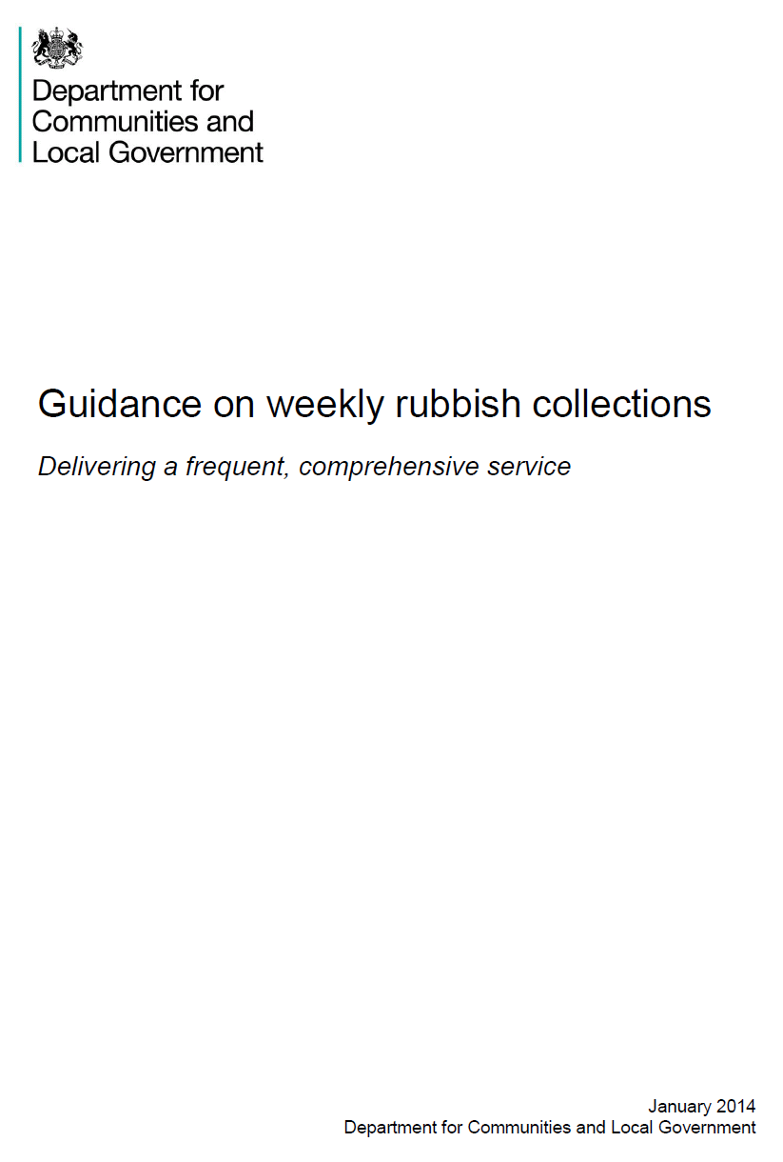
Weekly Collection Support Scheme
The Weekly Collection Support Scheme is a grant from the Department for Communities and Local Government
Total funding £3.36m, £2,472k revenue, £883k capital
The funding focuses on four key elements:
Retaining weekly collections
Delivering an incentives and awareness campaign
Harmonising weekly collections across the Borough
Increasing the opportunity to ‘recycle on the go’

Slide 4
Weekly Collection Support Scheme Achievements
Standard bins provided for all new premises May 2013
Waste Awareness and Recycling Incentives Campaign launched January 2014
21 innovative ’talking’ recycling bins installed June 2014
On street recycling and litter wheeled bin covers installed September and October 2014
Two new specialist recycling collection vehicles received October 2014

Slide 5
Weekly Collection Support Scheme Outcomes and Benefits
New larger capacity recycling bins in every ward, doubling on-street capacity and contributing to increasing recycling rates
More specialist recycling vehicles improving service continuity and enabling service improvements
Standardised bins improving service efficiency
Increased awareness of actions to minimise waste and increase recycling

Slide 6
Waste Collection Strategy Going Forward
Deliver objectives in the Waste Strategy
Managing our waste following the end of the Weekly Collection Support Scheme
Managing growth in the borough
Managing growth in waste

Slide 7
Waste Collection Options
Weekly, alternate weekly, three weekly or monthly collections of residual waste
Communal collection areas in areas of high density housing
Subscription for discretionary collections
Partnership working

Slide 8
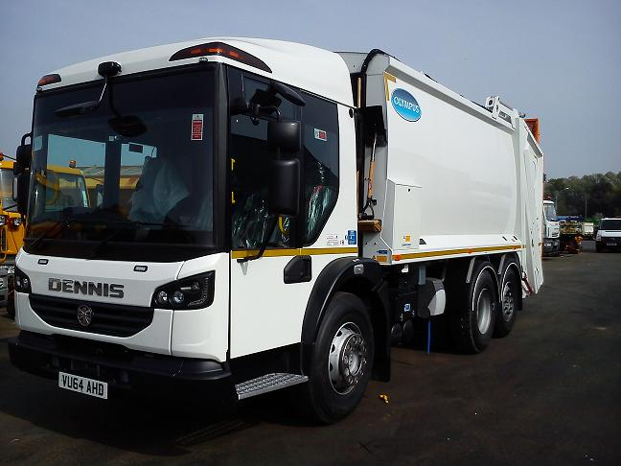
Waste Collection Options
Additional/smaller containers
Frequency of recycling collection
Underground collection systems
Weekly food waste collection

Slide 9
Questions

