Slide 1
Flood Risk Implementation Plan Update

Slide 2
Major Projects
Astley Drive
Dudley
Shiremoor & Wellfield

Slide 3
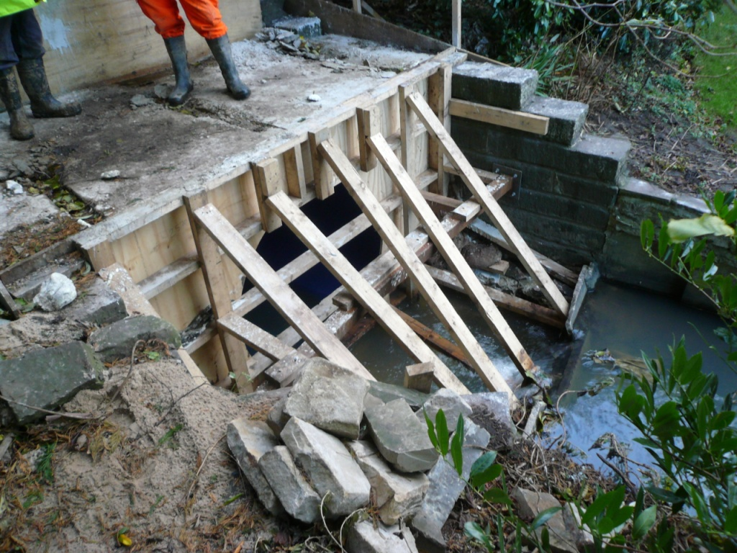
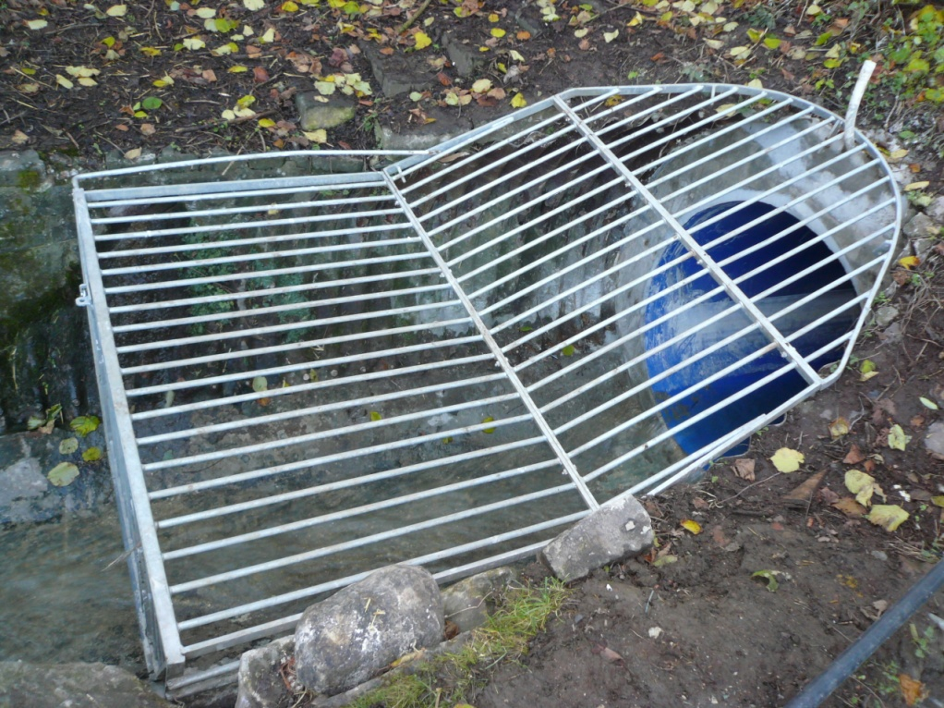
Astley Drive
Culvert replacement works nearing completion.
Inlet
Outlet

Slide 4
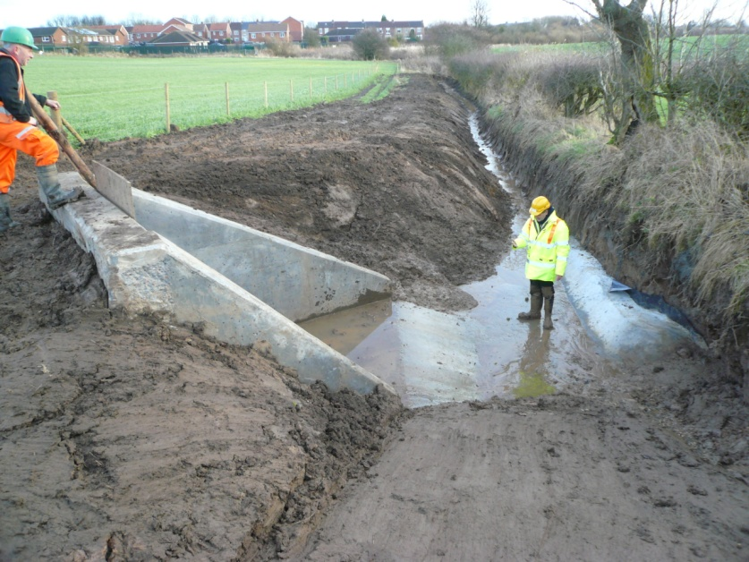
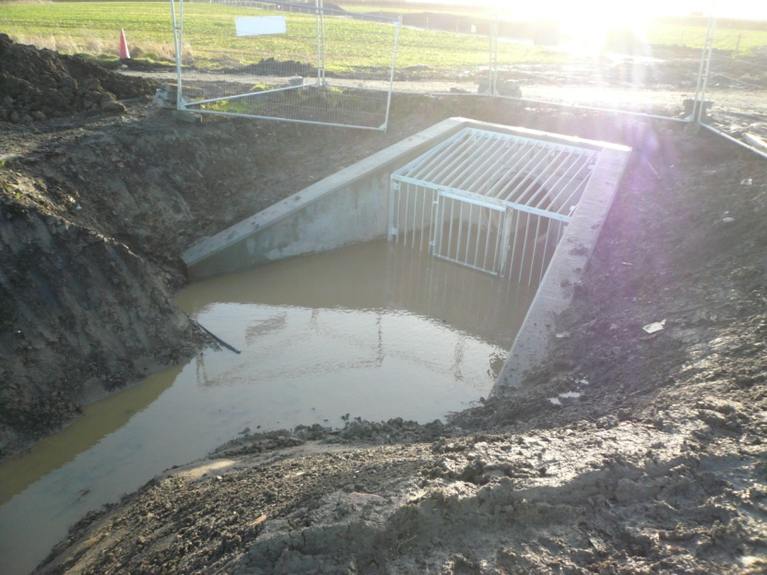
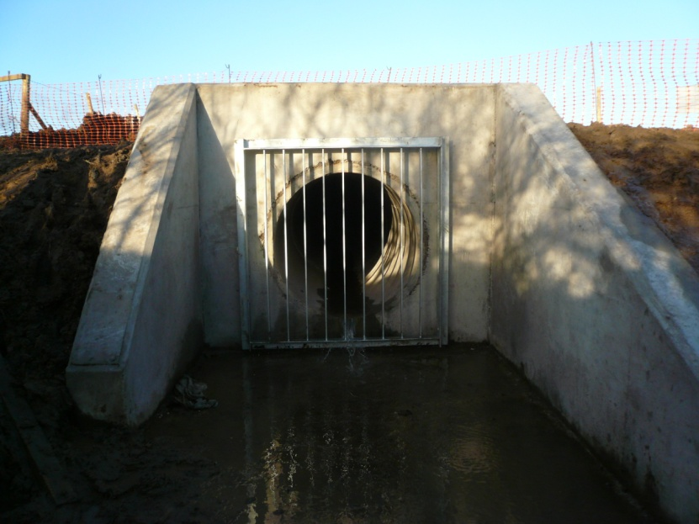
Dudley
Culvert installation complete.
Site clearance and replacement of topsoil to be carried out.

Slide 5
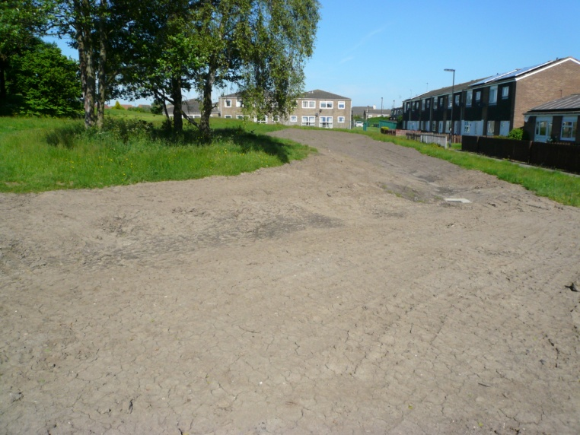
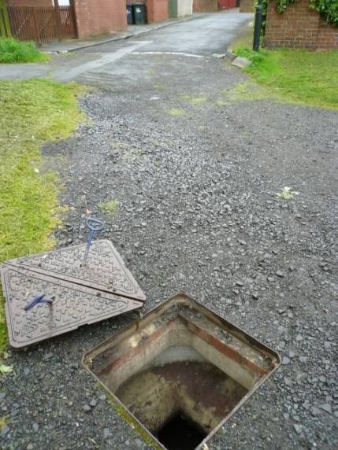
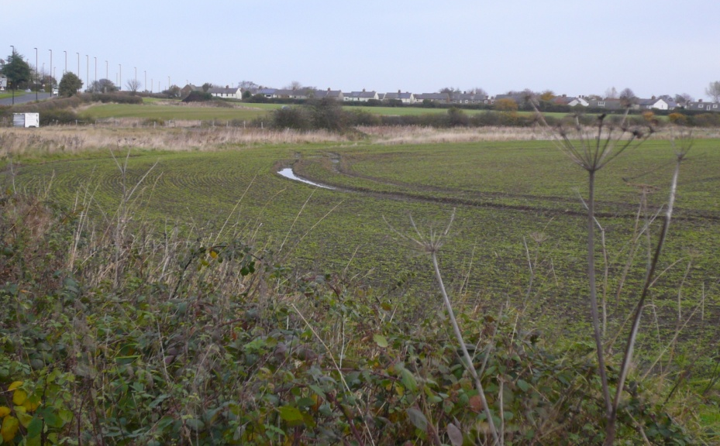
Shiremoor
Culvert works complete beneath waggonway & New York Road – Complete
Blue Bell pit heap swale and drainage – Complete
New culvert replacement / installation at Clara Avenue – February / March 2015
New attenuation pond between Shiremoor & Wellfield – Spring 2015

Slide 6
Ongoing Investigations
Wellfield
Otterburn Avenue
Briar Vale
Garth 22
Oak Grove
Allendale Crescent
Bywell Grove

Slide 7
Next Quarter
Physical work commencing on the ground on a number of the schemes:
Clara Avenue, Shiremoor
Oak Grove, Wallsend
Garth 22, Killingworth

Slide 8
Thank you

