Slide 1
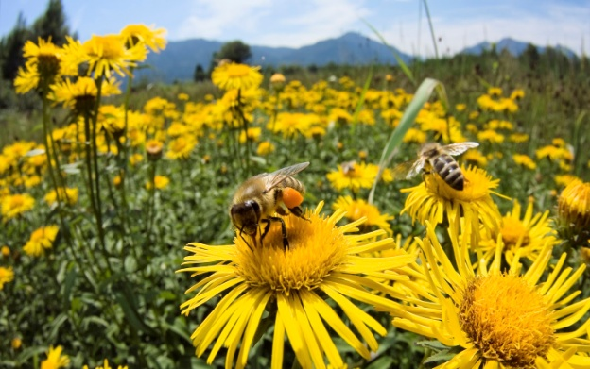
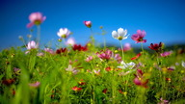
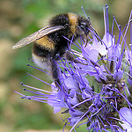
Increasing Biodiversity Areas Across North Tyneside

Slide 2
Background
Many of Britain’s birds, insects and plants are in decline (Defra, 2013)
Amenity areas and especially road verges provide ideal locations for the growth of wild plants and a potential food source for pollinators
Over recent years, we have increased the number of biodiversity sites across North Tyneside
Wildlife groups and some residents would like to see an increase in biodiversity areas.
Notes:
Povide you with an overview of proposals to establish more biodiversity areas across the borough, incorporating bee friendly planting and establishing swathed grass areas.
Background
Environment and Leisure Services has over recent years, increased the number of biodiversity sites across North Tyneside. This proposal will identify further sites to trial as biodiversity areas.
We know that many of our residents would like to see an increase in biodiversity areas. Wildlife interest groups such as the charity “Plantlife” are also campaigning for councils to manage their road side verges, particularly with wildflowers in mind. This campaign has been endorsed by Alan Titchmarsh, who launched the 'Alan Challenge', a guide to good road verge management.
The trialled change in the management of some grass areas will result in a more effective use of resources during the early part of the growing season, when demands on grass cutting services are at its highest.
Information
Many of Britain’s birds, insects and plants are in decline (Defra, 2013). Amenity areas and especially road verges provide ideal locations for the growth of wild plants. If wildflowers are left to set seed, this is not only good for their own survival but they also support populations of insects, birds and mammals. With the loss of our natural meadows, wildflowers on road verges (and other amenity land) also play a vital role as a food source for pollinators; six species of bumblebee have declined by 80% in the last 50 years, with 71% of butterflies also in decline. Healthy road verges offer good wildlife corridors, allowing both plants and animals to survive in an intensively managed landscape (Plantlife, 2013).
The proposal supports the Council’s strategy to ensure North Tyneside is a better place to live, work and visit and meets the aims and objectives set out in the Newcastle and North Tyneside Biodiversity Action Plan and Defra’s National Pollinator Strategy - for bees and other pollinators in England. Defra’s 10 year strategy aims to support pollinators across towns, cities and the countryside by providing food, shelter and nest sites.
£25k has been identified for the creation of further biodiversity areas, some of which will be used for seed sowing of pictoral and wild flower meadows, and interpretation signs. Schools will be encouraged to get involved in the creation and evaluation of the biodiversity areas and to create their own.

Slide 3
Proposal
To identify and trial new biodiversity areas across the borough
Safety considerations will be given to sight lines at road junctions and their approaches
Annual / perennial flower mixes will be sown at selected strategic sites within the borough
The trialled change in the management of some grass areas will result in a more effective use of resources
We will work closely with schools through the Bee Programme
Notes:
These areas will remain uncut until October.
For the purposes of visual amenity, it may be necessary to cut some areas earlier than OctoberWe know that many of our residents would like to see an increase in
biodiversity areas. Wildlife interest groups such as the charity “Plantlife”
are also campaigning for councils to manage their road side verges,
particularly with wildflowers in mind. This campaign has been endorsed by Alan Titchmarsh, who launched the 'Alan Challenge', a guide to good road verge management.
Implementation of the proposals
Identified areas of grass will be left uncut until October. The balance will be maintained between formally managed, frequently cut spaces for recreation and less formal infrequently cut areas for biodiversity. The trial will enable species which are present in the grass areas to have the opportunity to grow, flower and set seed. This will attract associated species such as pollinators. There will also be opportunities to improve the biodiversity of these areas further by sowing/planting wildflowers within them.
Depending upon the success of the trial, some of the biodiversity areas could be further extended. In addition, some sites may be appropriate to develop further into woodlands / copses by planting with native tree species in association with the Woodland Trust.
For reasons of safety, sight lines will continue to be cut at road junctions and their approaches. If necessary, pathways will be cut in biodiversity areas covering large areas, these will also act as fire breaks to reduce fire risk.
For the purposes of visual amenity, it may be necessary to cut some areas earlier than October.
Annual / perennial flower mixes will be sown at selected strategic sites within the borough. The mixes will be sown to maximise on colour from the flowering display and a positive response from residents and visitors to the borough is anticipated.

Slide 4
Criteria for locations
Locations have been selected based on the following:
The sites are within open spaces that could accommodate areas of longer grass without having a major impact on recreational use
The sites are areas of central reservations, bank sides or roadside verges
The sites are areas where bulbs have been planted and to benefit wildlife the grassed area could be left uncut for a longer period than currently practiced.
Notes:
These areas are not used for recreation and therefore do not need to be cut regularly.
Proposed locations
North West Area
Parts of Sandy Lane
Few areas in Stalks Road, near the bridge
Pylon field, swathe around the pylons and margins
Birchwood Avenue, swathe the woodland margin
Burnbridge, tree understory and corner
Dudley Lane, beside hedge and roadside
B1321 and Love Avenue, tree understory
Fern Drive, increase the swathes beside the burn
Burradon Road, leave single mowing strip
Weetslade Road, strips between trees and field margin
B 1317 Killingworth Way, single mowing strip.
Backworth Lane, single mowing strip on North side
Castle Square, tree understory
Holystone Way, single swathe and waggonways
Whitley Road, single mowing strip
Forest hall Road and Great Lime Road, tree understory
Southgate, tree understory
Station Road, selective large existing mown areas, areas, tree understorey
Far end of Fusilier Field
Cat and Dog shelter field, swathing around trees
East and West Bailey, selective areas
Garth 21, bankside at Megstone Court and Alderley Drive
Ongar Way, swathe beside Quorum Business Park
South West Area
Rear Wharfedale / Wensleydale (cut paths)
Hill by Aldi’s, rear Airedale / Deepdale (cut paths)
Rear Regents Park / Holland Pk / Home Pk (cut paths)
Rear Home Pk / Wiltshire Dr / Coast Rd
Chicken Rd Field (Cut paths to play area)
Battle Hill Dene (cut paths)
Black path Battle Hill / Hadrian Park (cut paths)
Rear Blackhill Ave. parallel with A19
A19 / Melrose / Henley Gds
A19 / Firtrees Ave
Wallsend Burn
Archer St Field (Cut paths and football size area)
Hadrian Rd (cut against the road)
North East Area
A1148 Monkseaton Drive, swathed areas
Brierdene, rig and furrow, swathe in beside footpath
Trinity Road banksides
Links swathe around Brierdene Burn
Shiremoor Bypass
Bankside at end of Plessey Crescent
Swathes in Preston Road
Swathe grass strip between Zetland Drive and Hampton Road Marden
Marden Road South / Broadway adjacent to Marden Quarry
South East Area
Bank sides entrance to Yeoman street North Shields
Rake Lane / Westminster Road area
New York Road / By – pass
A selection of the sites listed below will be sown, the nine sites to date for consideration include:
Coast Rd / Rear of Battle Hill Drive shops
Station Rd, Benton
Wallsend Parks – Arboretum, overlooked from Coast Road
Southgate bank in front of George Stephenson High School
Holystone Way
Weetslade Road
Killingworth Way
Monkseaton Drive
Preston Road

Slide 5
Communication
In March, a description of the trial, including a list of sites and frequently asked questions will be placed on the Council’s website
Ward Councillors will be given the opportunity to suggest additional sites and discuss the proposals in their Wards
In April, display notices will be placed at biodiversity sites explaining their purpose, including the benefits to wildlife
Feedback from residents will be closely monitored
Notes:
The following communication plan is proposed :
In March, a description of the trial, including a list of sites and frequently asked questions will be placed on the Council’s website. Information will also be shared with the Communications Team, Customer Services and Elected Members,(via the Members newsletter), to support the management of public enquiries.
Officers from Environment and Leisure will offer Ward Councillors the opportunity to suggest additional sites and discuss the proposals in their wards.
In April, display notices will be placed at biodiversity sites explaining their purpose including the benefits to wildlife.
As the growing season continues, feedback from residents will be monitored and further information shared, where considered necessary to assist in the management of the trials.

Slide 6
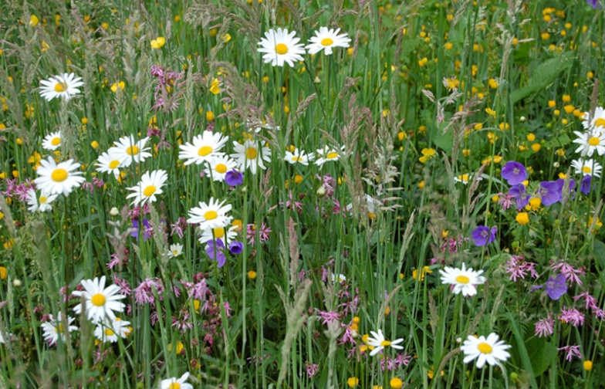
Evaluation of the trial
The success of the trial will be evaluated through the following:
Public/Member response
Increase in biodiversity/wildlife
Efficient use of resources

